Slide 1
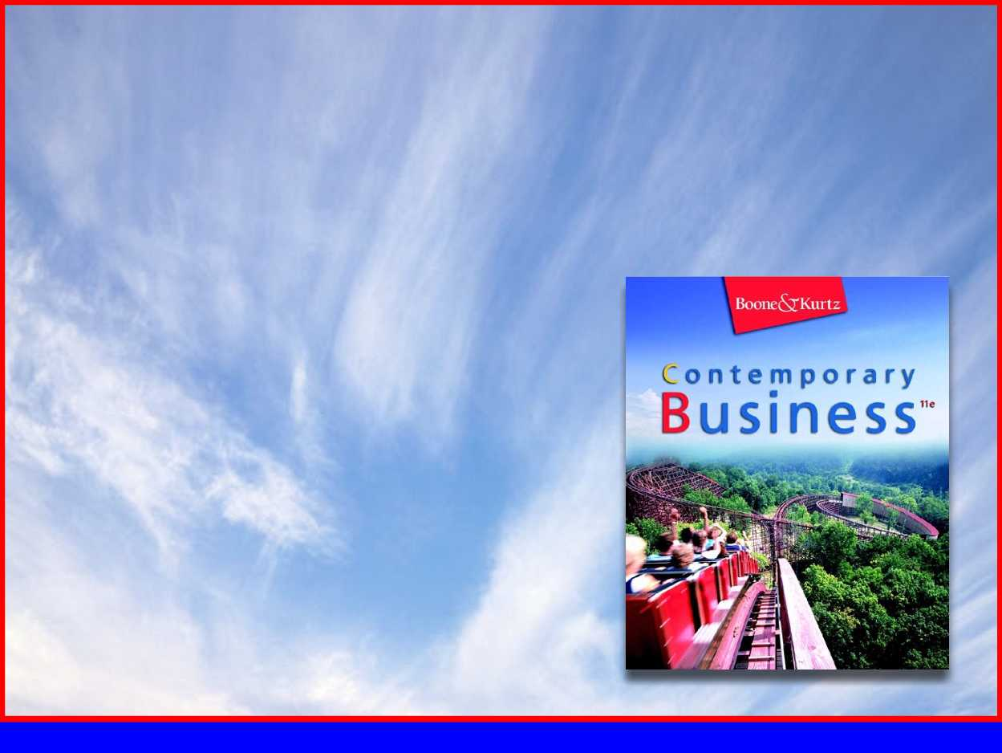
Part 4
Marketing Management

Slide 2
Chapter 12
Customer-Driven Marketing

Slide 3

Chapter Objectives
Summarize the ways in which marketing creates utility.
Explain the marketing concept and relate hcompany wide satisfaction contributes to added value.
Describe the components of a market and distinguish between B2B and B2C marketing.
Outline the basic steps in developing a marketing strategy.
Describe the marketing research function.
Identify each of the methods available for segmenting consumer and business markets.
Distinguish between buyer behavior and consumer behavior.
Discuss the benefits of relationship marketing.

Slide 4
What is Marketing?
Marketing—process of planning and executing the conception, pricing, promotion, and distribution of ideas, goods, services, organizations, and events to create and maintain relationships that satisfy individual and organizational objectives.
  Exchange process—when two or more parties benefit from trading things of value
Notes:
Marketing is the link between the organization and the people who buy and use its products
Marketers use the data to understand the needs and wants of both final customers and business buyers so that they can satisfy them.
Marketing
1. It begins with discovering unmet customer needs and continues with researching the potential market.
2. Producing a good or service capable of satisfying the targeted customers; and promoting, pricing, and distributing that good or service
3. When two or more parties benefit from trading things of value, they have entered into an exchange process
4. The exchange process allows each group to concentrate on what it does best and then trading excess goods for scarce ones

Slide 5
What is Marketing?
How Marketing Creates Utility
  Utility—want-satisfying power of a good or service.
    Production creates form utility
    Marketing creates time, place, and ownership utility
Notes:
1. Marketing is a complex activity that affects many aspects of an organization and its dealings with customers.
2. The ability of a good or service to satisfy the wants and needs of customers is called utility.
3. Time utility is created by making a good or service available when customers want to purchase it.
4. Place utility is created, by making products available in a location convenient for customers.
5. Ownership utility refers to an orderly transfer of goods and services from the seller to the buyer.

Slide 6
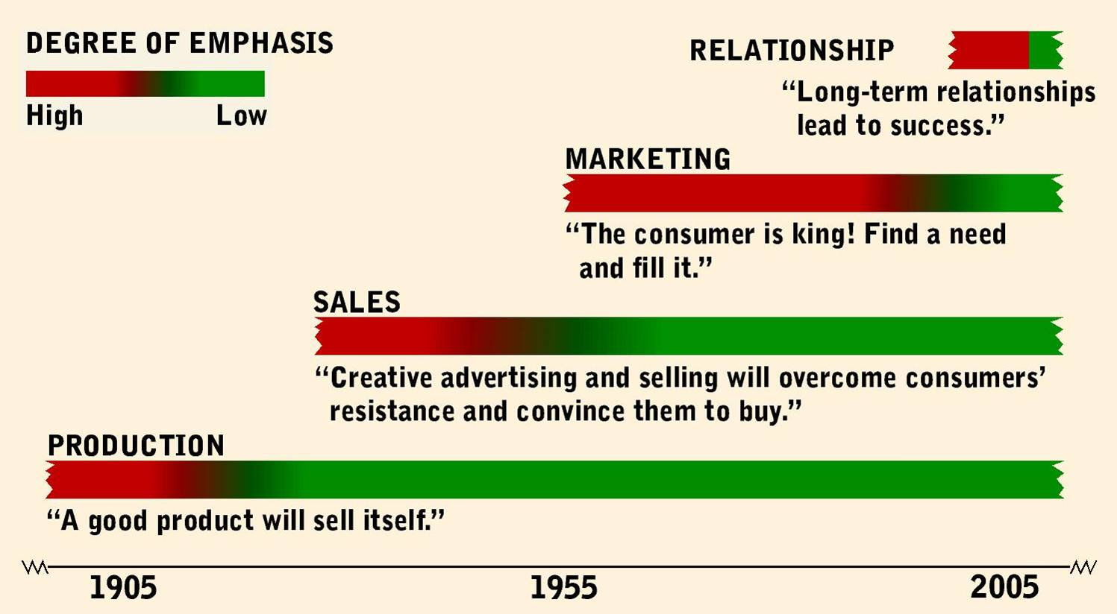
Evolution of the Marketing Concept
Over time, marketing activities evolved
Four Eras in the History of Marketing
Notes:
A. For centuries, organizations of the production era stressed efficiency in producing quality products
B. Organizations did not fully recognize the importance of their customers until the marketing era of the 1950s, when they began to adopt a consumer orientation
C. This focus has intensified in recent years, leading to the emergence of the relationship era, whose emphasis is on customer satisfaction

Slide 7
Evolution of the Marketing Concept
Emergence of the Marketing Concept
  Marketing concept—company wide consumer orientation to promote long-run success.
    Shift from seller’s market to buyer’s market
Notes:
1. The term marketing concept refers to a company-wide customer orientation with the objective of achieving long-run success.
2. A firm should analyze each customer’s needs and then work backward to make products that fulfill them.
3. The emergence of the marketing concept can be explained best by the shift from a sellers market - one with a shortage of goods and services - to a buyer’s market - one with an abundance of goods and services.

Slide 8
Evolution of the Marketing Concept
Delivering Added Value through Customer Satisfaction and Quality
  Customer Satisfaction—result of a good or service meeting or exceeding the buyer’s needs and expectations.
Notes:
The best way to keep a customer is to offer more than just products-- customers today want value.

Slide 9
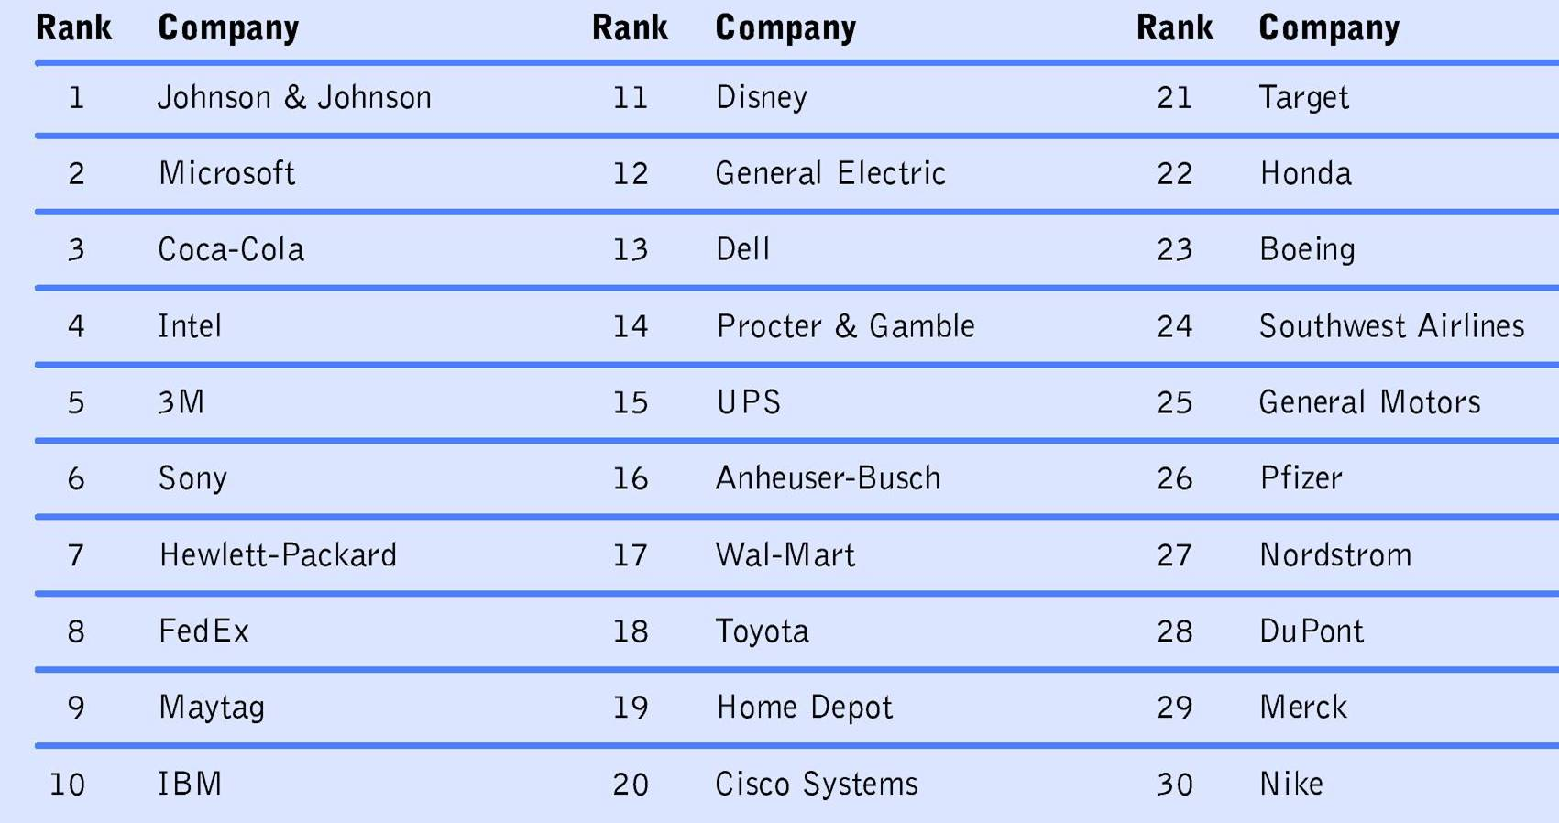
The Top 30 Companies for Customer Service

Slide 10
Evolution of the Marketing Concept
Delivering Added Value through Customer Satisfaction and Quality
  Value-added—occurs when a company exceeds value expectations by adding features, lowering its price, enhancing customer service, or making other improvements to increase customer satisfaction
    Quality
Notes:
Quality
a. the degree of excellence or superiority of an organization’s goods and services
b. another way firms enhance customer satisfaction
c. can encompass both the tangible and intangible characteristics of a good or service
d. relates to physical product traits, such as durability and reliability
e. also includes customer service

Slide 11
Evolution of the Marketing Concept
Delivering Added Value through Customer Satisfaction and Quality
  Customer Satisfaction and Feedback
    Important to find out how buyers perceive the company or its products by obtaining customer feedback through:
      Toll-free telephone hotlines
      Customer satisfaction surveys
      Web site message boards
      Written correspondence
Notes:
Customer Satisfaction
1. critical for building long-lasting relationships
2. The fundamental premise of the marketing concept is to focus all organizational efforts on providing superior customer service to retain existing customers and attract new ones.
Obtaining Customer Feedback
1. One of the best ways to find out how buyers perceive a company or its products
2. Customer complaints are excellent sources of customer feedback, since they present companies with an opportunity to overcome problems and improve their services

Slide 12
Expanding Marketing’s Traditional Boundaries
Not-for-Profit Marketing
  Not-for-profit organizations benefit by applying many of the strategies and concepts used by profit-seeking firms
  May apply marketing tools to reach their audiences, secure funding, improve their images, and accomplish their overall missions
  Some form a partnership with profit-seeking companies
Notes:
The marketing concept has traditionally been associated with products of profit-seeking organizations.
Not-for-profit organizations operate in both public and private sectors
a. Public sectors include:
•federal government
•state governments
•local governments
•agencies that receive tax funding
Private not-for-profit sector comprises many different types of organizations, including:
•labor unions
•hospitals, community recreation programs
•art museums
•local youth organizations

Slide 13
Expanding Marketing’s Traditional Boundaries
Nontraditional Marketing
  Growth in the number of not-for-profit organizations has forced them to adopt businesslike strategies and tactics to successfully compete

Slide 14
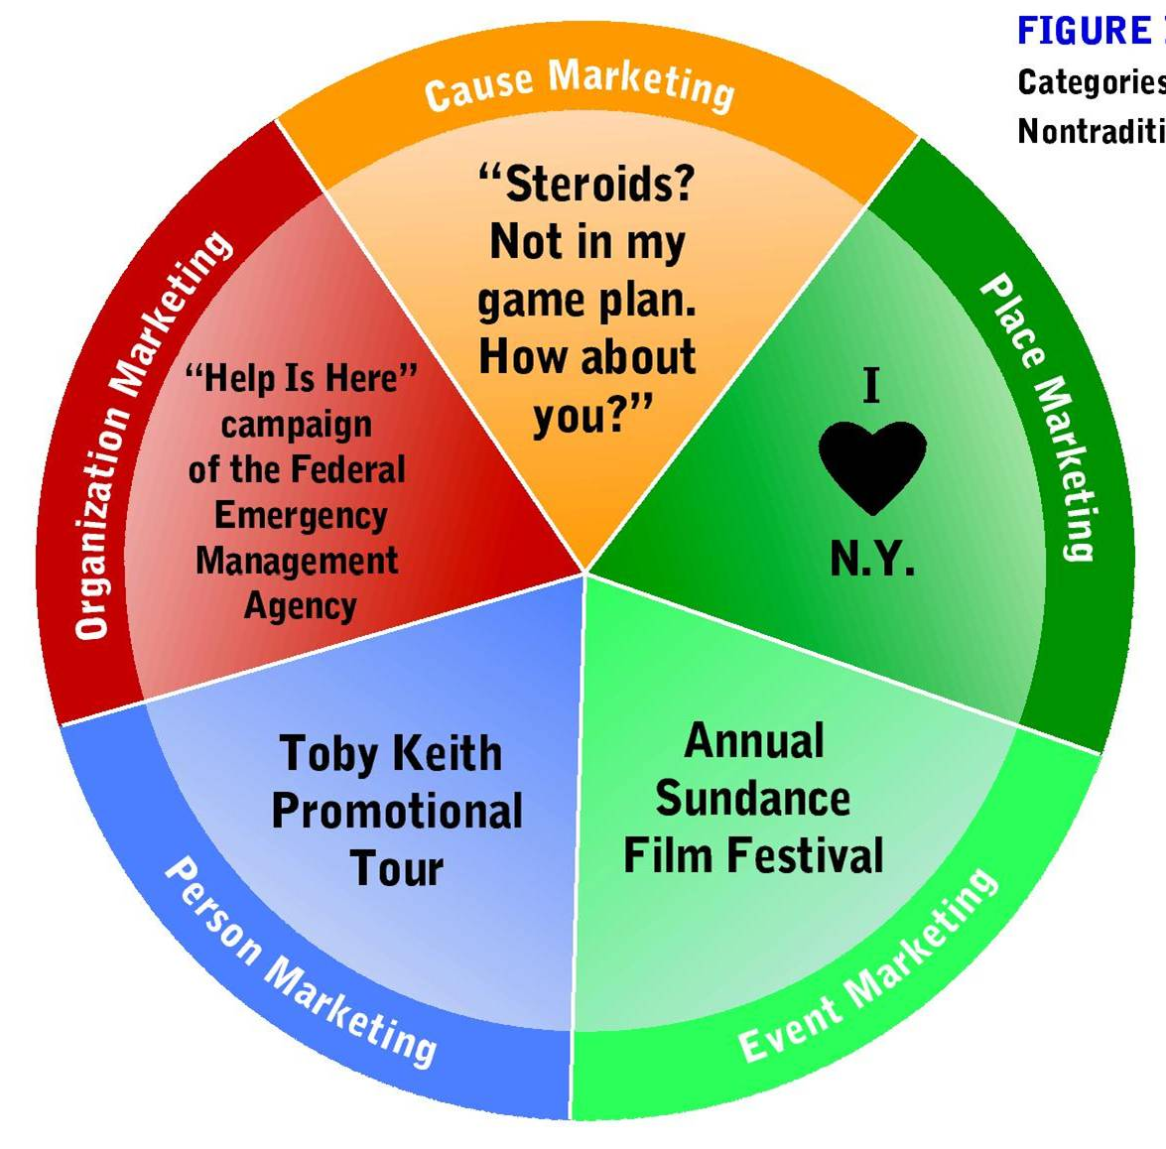
Categories of Nontraditional Marketing

Slide 15
Expanding Marketing’s Traditional Boundaries
Nontraditional Marketing
  Person Marketing—efforts designed to attract attention, interest, and preference of a target market toward a person
  Place Marketing—attempts to attract people to a particular area, such as a city, state, or nation

Slide 16
Expanding Marketing’s Traditional Boundaries
Nontraditional Marketing
  Cause Marketing—efforts to promote a cause or social issue, such as the prevention of child abuse, antilittering efforts, and anti-smoking campaigns

Slide 17
Expanding Marketing’s Traditional Boundaries
Nontraditional Marketing
  Event Marketing—marketing or sponsoring short-term events such as athletic competitions and cultural and charitable performances
  Organization Marketing—attempting to influence consumers to accept the goals of, receive the services of, or contribute in some way to an organization

Slide 18
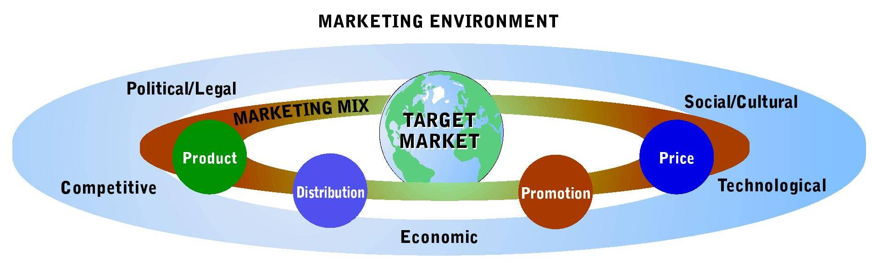
Developing a Marketing Strategy
Target Market and Marketing Mix within the Marketing Environment
Notes:
1. Decision-makers in any successful organization, for-profit, or not-for-profit, follow a two-step process to develop a marketing strategy:
a. They study and analyze potential target markets and then choose among them.
b. They create a marketing mix to satisfy the chosen market
2. A written marketing plan often becomes a key component of a firm’s overall business plan as it outlines its marketing strategy, includes information about the target market, sales, and revenue goals, and the timing for implementing the elements of the marketing mix.

Slide 19
Developing a Marketing Strategy
Selecting a Target Market
  Target Market—group of people toward whom an organization markets its goods, services, or ideas with a strategy designed to satisfy their specific needs and preferences.
    Consumer Products
    Business Products
Notes:
1. A market consists of people with purchasing power, willingness to buy, and authority to make purchase decisions.
2. Consumer products -- often known as business-to-consumer products -- are goods and services purchased by end users, such as DVDs, shampoo, and dental care.
3. Business products -- or business-to-business products -- are goods and services purchased to be used, either directly or indirectly, in the production of other goods for resale.
4. An organization’s target market is the group of potential customers toward whom it directs its marketing efforts.

Slide 20
Developing a Marketing Strategy
Developing a Marketing Mix
  Marketing Mix—blending the four elements of marketing strategy—product, distribution, promotion, and price—to satisfy chosen customer segments.
    Product strategy
    Distribution strategy
    Promotional strategy
    Pricing strategy
Notes:
Marketing success depends, not on the four individual strategies, but on their unique combination.
1. Product strategy -- involves more than just designing a good or service with needed attributes; it includes decisions about package design, a brand name, trademarks, warranties, product image, new-product development, and customer service.
2. Pricing strategy -- deals with the methods of setting profitable and justifiable prices.
3. Distribution strategy -- ensures that customers receive their purchases in the proper quantities at the right times and locations.
4. Promotional strategy -- involves informing, persuading, and influencing purchase decisions

Slide 21

Developing a Marketing Strategy
Developing a Marketing Mix for International Markets
Standardization versus Adaptation
  This ad was created for the U.S. Hispanic Market
Notes:
1. Marketing a good or service in foreign markets means deciding whether to offer the same marketing mix in every market -- standardization -- or to develop a unique mix to fit each market – adaptation.
2. The advantages of standardizing the marketing mix include reliable marketing performance and low costs.
3. Adaptation lets marketers vary their marketing mix to suit local competitive conditions, consumer preferences, and government regulations.
4. Increasingly, marketers are trying to build adaptability into the designs of standardized goods and services for international and domestic markets.
5. Mass customization allows a firm to mass-produce goods and services while adding unique features to individual orders.

Slide 22
Marketing Research for Improved Marketing Decisions
Marketing Research—collection and use of information to support marketing decision making.
Notes:
A. The process of collecting and evaluating information to help marketers make effective decisions is called marketing research.
B. It links marketing decision-makers to the marketplace by providing data about potential target markets that help them design effective marketing mixes

Slide 23
Marketing Research for Improved Marketing Decisions
Marketers Conduct Research for 5 basic reasons:
  Identify marketing problems and opportunities
  Analyze competitors’ strategies
  Evaluate and predict customer behavior
  Gauge the performance of existing products and potential for new ones
  Develop price, promotion, and distribution plans

Slide 24
Marketing Research for Improved Marketing Decisions
Obtaining Marketing Research
  Researchers use both internal and external data
    Internal data is generated within the researcher’s organization
    External data is gathered from sources outside their firms
    Primary Data
Notes:
Internal Data
They generate internal data within their organizations including financial records, which provide a tremendous amount of useful information, such as changes in unpaid bills, inventory levels, sales generated by different categories of customers or product lines, profitability of divisions, and comparisons of sales.
External Data
1. Researchers gather external data from sources outside their firms, including previously published data.
2. Low cost and quick, easy access prompt marketing researchers to begin searching for needed information by exhausting all possible sources of previously collected secondary data before investing the time and money required to collect firsthand data.
Primary Data
1. Primary data is data collected for the first time through observation or surveys.
2. Marketing researchers commonly collect primary data through observational studies, in which they view the actions of selected subjects, either directly or through mechanical devices.
3. When researchers need information about attitudes, opinions, and motives, they must ask questions by conducting surveys, which include telephone interviews, mail, fax, and online questionnaires.

Slide 25
Marketing Research for Improved Marketing Decisions
Applying Marketing Research Data
  As the accuracy of information collected by researchers increases, so does the effectiveness of resulting marketing strategies
    Examples:
      Products are improved
      Advertisements become more effective
      Customers are more satisfied
Notes:
1. Media ranging from television and radio stations to magazines and Web portals gather data about their audiences.
2. To convince would-be advertisers that they can target their ads to match consumer ages, geographic locations, gender, ethnicity, marital status, and product interests.

Slide 26
Marketing Research for Improved Marketing Decisions
Computer-Based Marketing Research Systems
  Universal Product Code (UPC)—computers identify the product, its manufacturer, and its price
  Marketing research firms store consumer data and commercially available databases
Data Mining—computer search of massive amounts of customer data to detect pattern and relationships.
  Data Warehouses
Notes:
Computer-Based Marketing Research Systems
1. Computer technology helps many businesses create a strategic advantage in collecting and analyzing research data.
2. Companies can gather detailed data with the Universal Product Code (UPC) symbols that appear on most packaging.
3. Managers use the data to schedule inventory, ordering, and delivery; track sales; and test the effectiveness of promotions and new-product introductions.
Data Mining
1. Accurate data mining can help researchers forecast recessions, weed out credit-card fraud, and pinpoint sales prospects.
2. Data mining uses data warehouses, which are sophisticated customer databases that allow managers to combine data from several different organizational functions.

Slide 27
Market Segmentation
Market Segmentation—process of dividing a total market into several relatively homogeneous groups.
  Paco Jeans
  Made Not for All Jeans Wearers, But for A Certain Market Segment
Notes:
A. The process of dividing a total market into several relatively homogeneous groups
B. Both profit-seeking and not-for-profit organizations use market segmentation to help them reach desirable target markets.
C. Attempts to isolate the traits that distinguish a certain group of customers from the overall market.

Slide 28
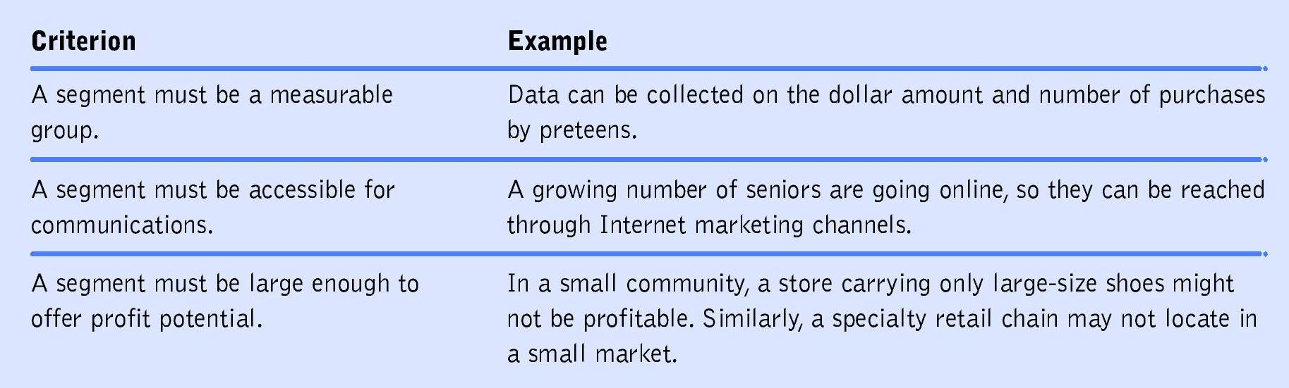
Market Segmentation
How Market Segmentation Works
Notes:
1. Depending on whether their firms offer consumer or business products, marketers segment their target markets differently.
2. Four common bases for segmenting consumer markets are:
•geographic segmentation
•demographic segmentation
•psychographic segmentation
•product-related segmentation
3. Business markets are segmented on only three criteria: customer-based segmentation, end-use segmentation, and geographic segmentation.

Slide 29
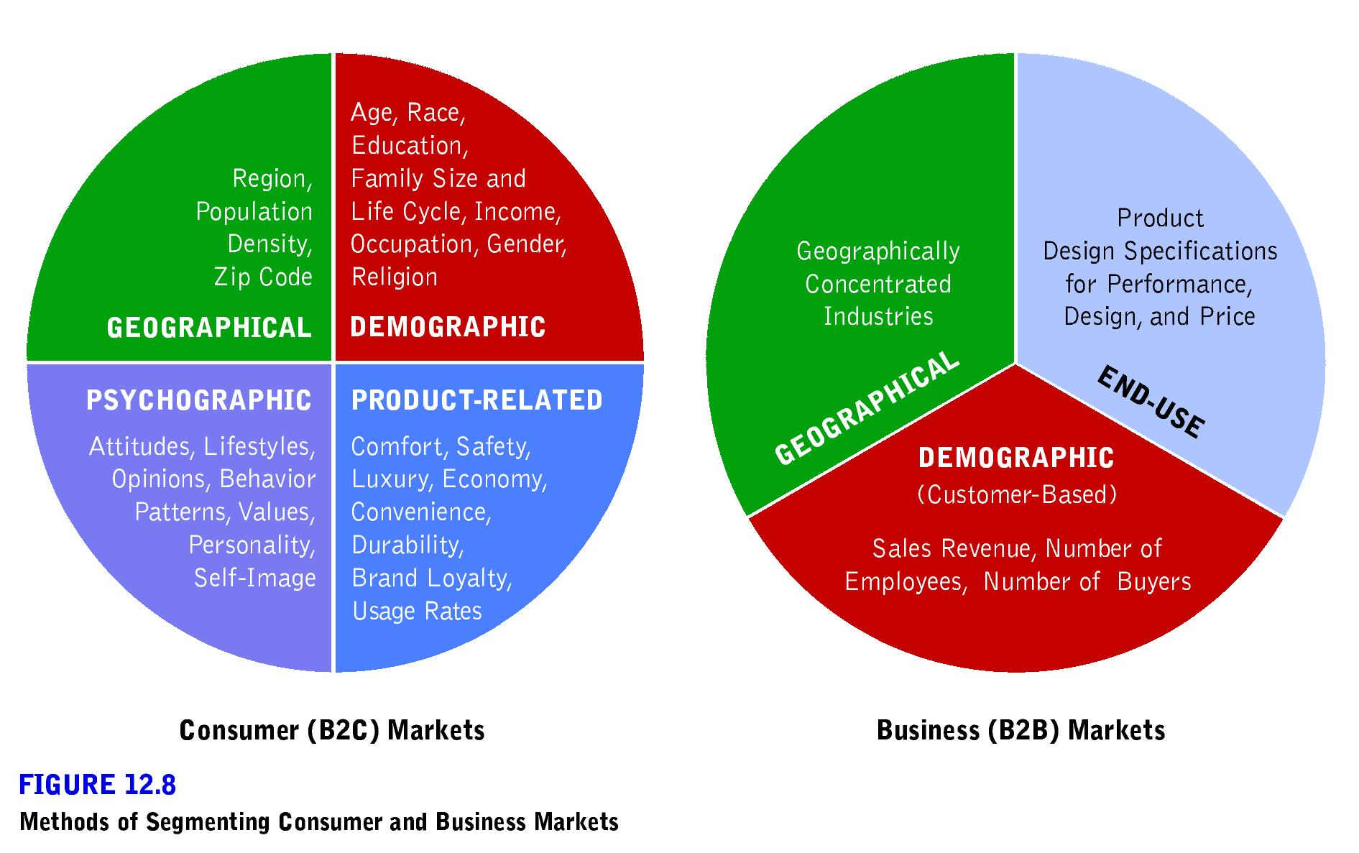
Methods of Segmenting Consumer Markets

Slide 30
Methods of Segmenting Business Markets

Slide 31
Market Segmentation
Segmenting Consumer Markets
  Geographic Segmentation—dividing an overall market into homogeneous groups on the basis of population locations
  Demographic Segmentation— distinguishes markets on the basis of various demographic or socioeconomic characteristics
Notes:
Geographic Segmentation
a. dividing an overall market into homogeneous groups on the basis of population locations
b. While geographic location does not ensure that consumers in a particular area will make the same kinds of buying decisions, this segmentation approach is useful when consumer preferences and purchase patterns for a good or service differ between regions.
c. Population size, a common geographic segmentation factor, helps define target markets as urban, suburban, and rural markets.
Demographic Segmentation
a. the most common method of market segmentation
b. distinguishes markets on the basis of various demographic or socioeconomic characteristics
c. common demographic measures include:
•income
•age--the most volatile factor in demographic segmentation in the US, with our rapidly aging population
•occupation, •household size
•stage in the family life cycle, •education
•ethnic group, •gender
d. Demographic segmentation is somewhat more difficult in foreign markets than in domestic ones, as some countries do not regularly conduct census studies of their populations and others.

Slide 32
Market Segmentation
Segmenting Consumer Markets
  Psychographic segmentation—divides consumer markets into groups with similar psychological characteristics, values, and lifestyles
  Product-related segmentation—dividing consumer market into groups based on buyers’ relationships to the good or service
Notes:
Psychographic Segmentation
a. divides consumer markets into groups with similar psychological characteristics, values, and lifestyles
b. lifestyle is the summation of a person’s needs, preferences, motives, attitudes, social habits, and cultural background.
Product-Related Segmentation
Marketers can divide a consumer market into groups based on buyers’ relationships to the good or service.
The three most popular approaches to product-related segmentation are based on:
a. benefits sought -- focuses on the attributes that people seek in a good or service and the benefits they expect to receive from it
b. usage rates
according to the amounts of a product that different consumers buy and use
light, medium, heavy
the 80/20 principle states that roughly 80 percent of a product’s revenues come from only 2 percent of its buyers
c. brand loyalty levels--degree to which customers recognize, prefer, and insist on a particular brand.

Slide 33
Market Segmentation
Segmenting Business Markets
  In many ways, business market segmentation resembles that for consumer markets
  In addition to geographic segmentation, business markets use:
    Demographic, or customer-based, segmentation
    End-use segmentation
Notes:
1. Resemble those for consumer markets
2. Demographic, or customer-based segmentation begins with a good or service design intended to suit a specific organizational markets.
3. To simplify the process of focusing on a particular type of business customer, the federal government recently established a new system called the North American Industry Classification System (NAICS) for classifying businesses.
4. End-Use segmentation focuses on the precise way a B2B purchaser will use a product.

Slide 34
Buyer Behavior: Determining What Customers Want
Buyer Behavior—series of decision processes by individual consumers who buy products for their own use and organizational buyers who purchase business products to be used directly or indirectly in the sale of other items.
Consumer Behavior—actions of ultimate consumers directly involved in obtaining, consuming, and disposing of products and the decision processes that precede and follow these actions.

Slide 35
Buyer Behavior: Determining What Customers Want
Determinants of Consumer Behavior
  Both personal and interpersonal factors influence the behavior of a consumer
  Personal influences on consumer behavior include individual needs and motives, perceptions, attitudes, learned experiences, and their self-concepts
  The interpersonal determinants of consumer behavior include cultural, social, and family influences

Slide 36
Buyer Behavior: Determining What Customers Want
Determinants of Business Buying Behavior
  Relationship marketing—goes beyond an effort for making the sale to a drive for making the sale again and again
    Managing relationships instead of simply completing transactions often leads to creative partnerships
Notes:
1. A large number of people can influence purchases of B2B products.
2. Business buyers face a variety of organizational influences in addition to their own preferences.

Slide 37
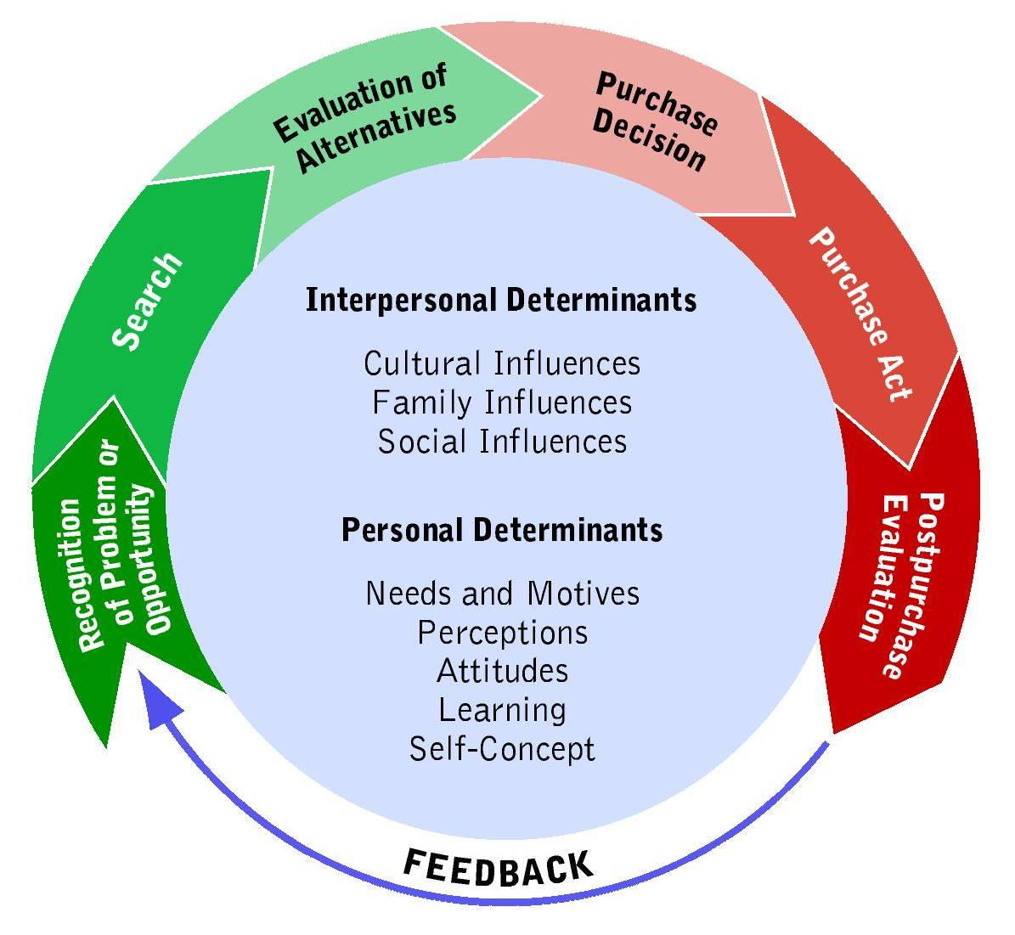
Steps in the Consumer Behavior Process
Notes:
1. Follows the sequential process with interpersonal and personal influences affecting every step.
2. Begins when the consumer recognizes a problem or an opportunity.
3. To solve the problem or take advantage of the opportunity, the consumer seeks out information about the intended purchase and evaluates alternatives, such as available brands.

Slide 38
Creating, Maintaining, and Strengthening Marketing Relationships
Transaction Marketing—characterized by buyer and seller exchanges with little or no ongoing relationships between parties
Relationship Marketing—developing and maintaining long-term, cost-effective exchange relationships with individual customers, suppliers, employees, and other partners for mutual benefit.
Notes:
A. Most businesses have traditionally focused on transaction marketing, characterized by buyer and seller exchanges with limited communications and little or no ongoing relationships between the parties.
B. Many firms are turning their attention away from managing transactions to the broader issues of relationship marketing
C. Relationship marketing goes beyond an effort for making the sale to a drive for making the sale again and again.
D. The following list reviews a few ways businesses are using relationships to reach corporate goals:
•Partnering with customers
•Partnering with suppliers
•Partnering with other businesses

Slide 39
Creating, Maintaining, and Strengthening Marketing Relationships
Benefits of Relationship Marketing
  Can help all parties involved by:
    Mutual protection against competitors
    Lower costs
    Higher profits
    Preferential treatment
  Lifetime value of a customer
Notes:
1. By identifying current purchasers and maintaining positive relationships with them, organizations can efficiently target their best customers.
2. Companies seek a higher lifetime value of a customer, which is the revenues the intangible benefits from the consumer over the life of the relationship, minus the amount the company must spend to acquire and serve that customer.

Slide 40
Creating, Maintaining, and Strengthening Marketing Relationships
Tools for Nurturing Customer Relationships
  Frequency Marketing and Affinity Programs
    Frequency Marketing—program that rewards purchases with cash, rebates, merchandise, or other premiums
    Affinity Program—marketing effort sponsored by an organization solicits involvement by individuals who share common interest and activities
Notes:
1. While businesses should not ignore any customer, of course, their objectives and tactics for managing relationships with individual customers often reflect the overall value to the firm of the resulting business.
2. Popular techniques through which firms try to build and protect customer relationships include frequent-buyer and frequent-user programs.
3. A frequency-marketing program is one that rewards purchasers with cash, rebates, merchandise, or other premiums.
4. An affinity program is a marketing effort sponsored by an organization that solicits involvement by individuals who share common interests and activities.

Slide 41
Creating, Maintaining, and Strengthening Marketing Relationships
Tools for Nurturing Customer Relationships
  Frequency Marketing and Affinity Programs
    Co-marketing—two businesses jointly market each other’s products
    Co-branding—occurs when two or more businesses team up to closely link their names for a single product
Notes:
1. In a co-marketing deal, two businesses jointly market each other’s products.
2. When two or more businesses team up to closely link their names for a single product, co-branding occurs.

Slide 42
Creating, Maintaining, and Strengthening Marketing Relationships
Tools for Nurturing Customer Relationships
  One-on-One Marketing
    The ability to customize product offering to individual needs and rapidly deliver good and services to customers.
Notes:
Whatever the technology, the success of relationship marketing depends not on the type of software or the size of the database, but on how well the company uses data to meet customer needs.

